Slide 1
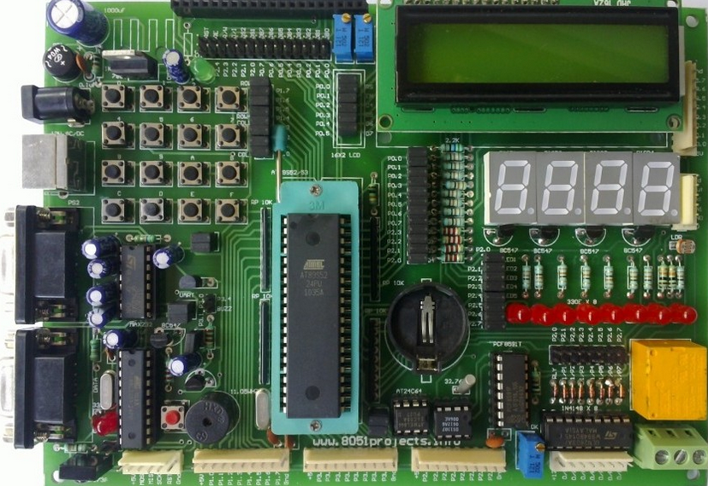
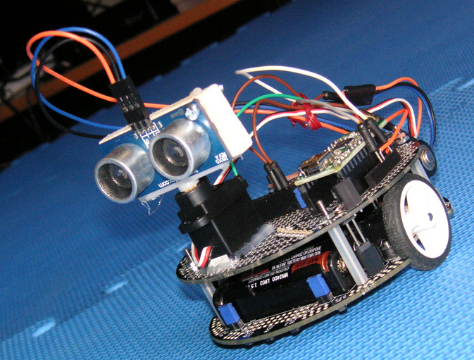
8051 MICROCONTROLLER
AND
EMBEDDED SYSTEMS

Slide 2
8051 PROGRAMMING IN C
The reasons for writing programs in C
Easy to Learn and Write
Faster Development Time
It is easier and less time consuming to write in C than Assembly.
C is easier to modify and update
You can use code available in function libraries.
C code is portable to other microcontroller with little of no modification.
Availability of Compilers
Maintenance and Readability
Supports Advanced Concepts

Slide 3
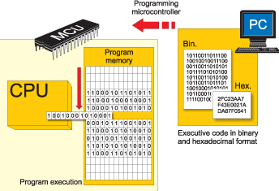
DATA TYPES
Data Type | Size in bits | Data range/Usage
Unsigned Char | 8 | 0 to 255 (0 - FF).
signed Char | 8 | -128 to +127
Unsigned int | 16 | 0 to 65535 (0 - FFFF).
signed int | 16 | -32,768 to +32,767
Sbit | 1 | SFR bit addressable only
bit | 1 | RAM bit addressable only
SFR | 8 | RAM addresses 80-FF H only

Slide 4
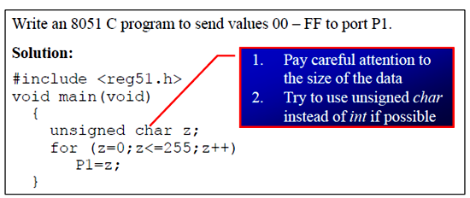
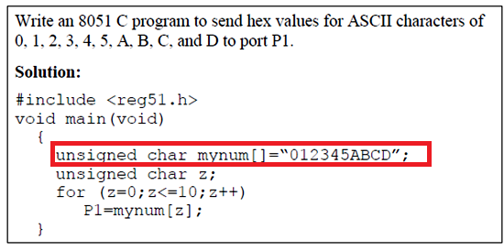

Slide 5
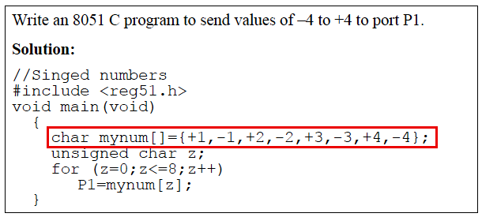
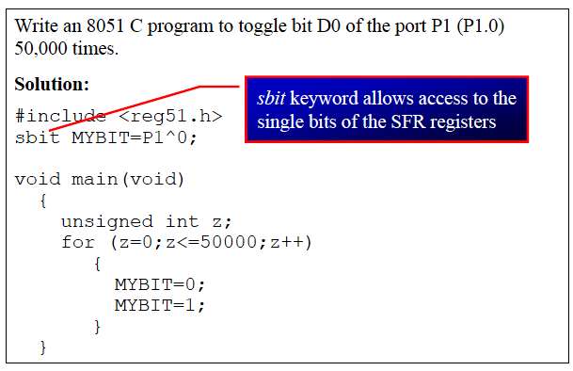

Slide 6
TIME DELAY
There are two way s to create a time delay in 8051 C
Using the 8051 timer
Using a simple for loop
be mindful of three factors that can affect the accuracy of the delay
The 8051 design
– The number of machine cycle
– The number of clock periods per machine cycle
The crystal frequency connected to the X1 – X2 input pins
Compiler choice
– C compiler converts the C statements and functions to Assembly language instructions
– Different compilers produce different code

Slide 7
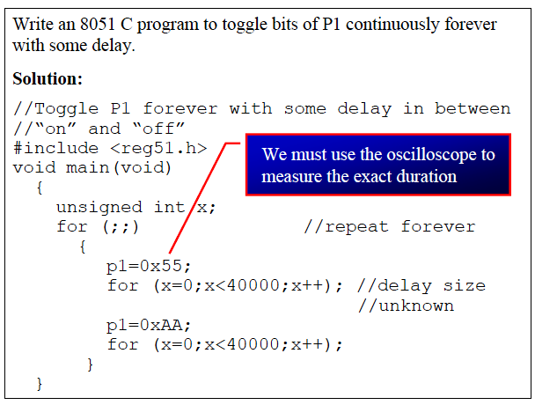
Conti…

Slide 8
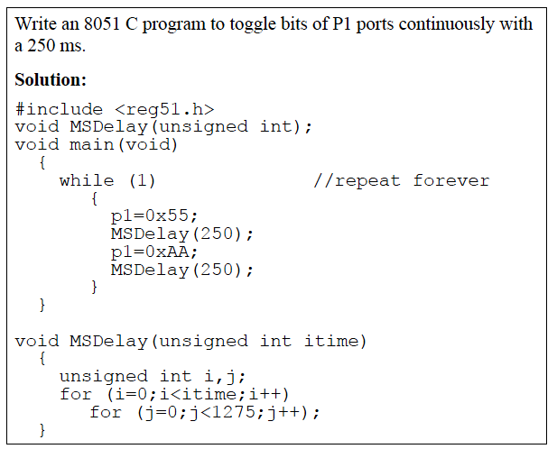
Conti…

Slide 9
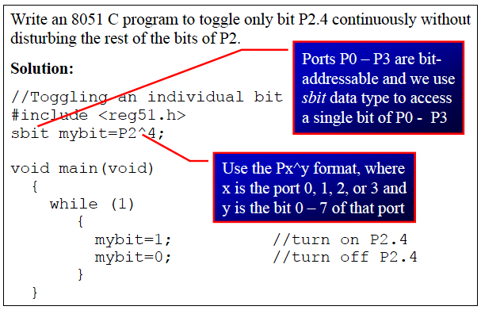
Conti…

Slide 10
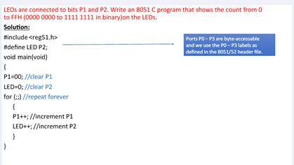
I/O programming in 8051 in C

Slide 11
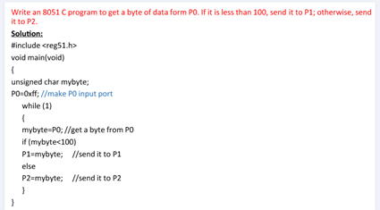

Slide 12
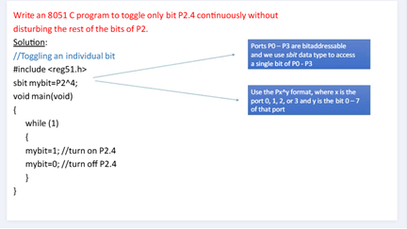

Slide 13
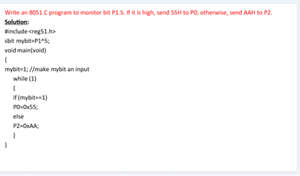

Slide 14
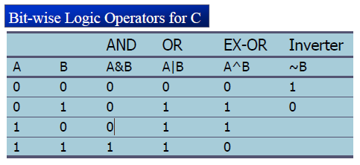
LOGIC OPERATIONS
Logical operators
AND (&&), OR (||), and NOT (!)
Bit-wise operators
AND (&), OR (|), EX-OR (^), Inverter (~),
Shift Right (>>), and Shift Left (<<)

Slide 15
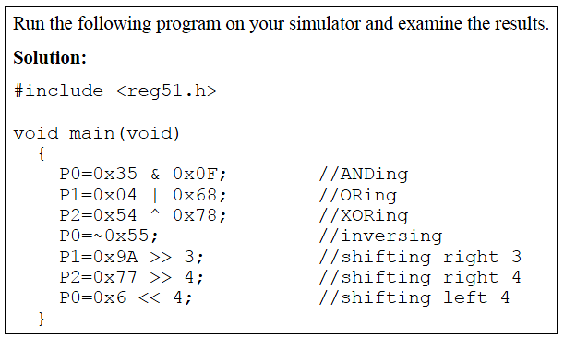
Conti…

Slide 16
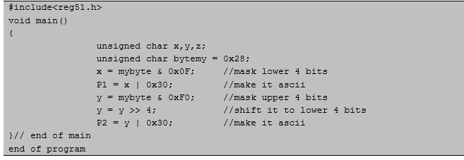
DATA CONVERSION in8051 C
Packed BCD to ASCII

Slide 17
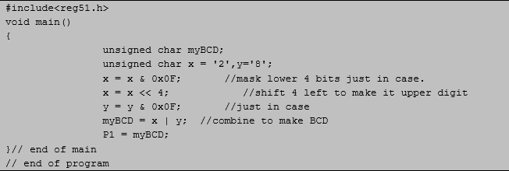
ASCII to Packed BCD.

